Slide 1
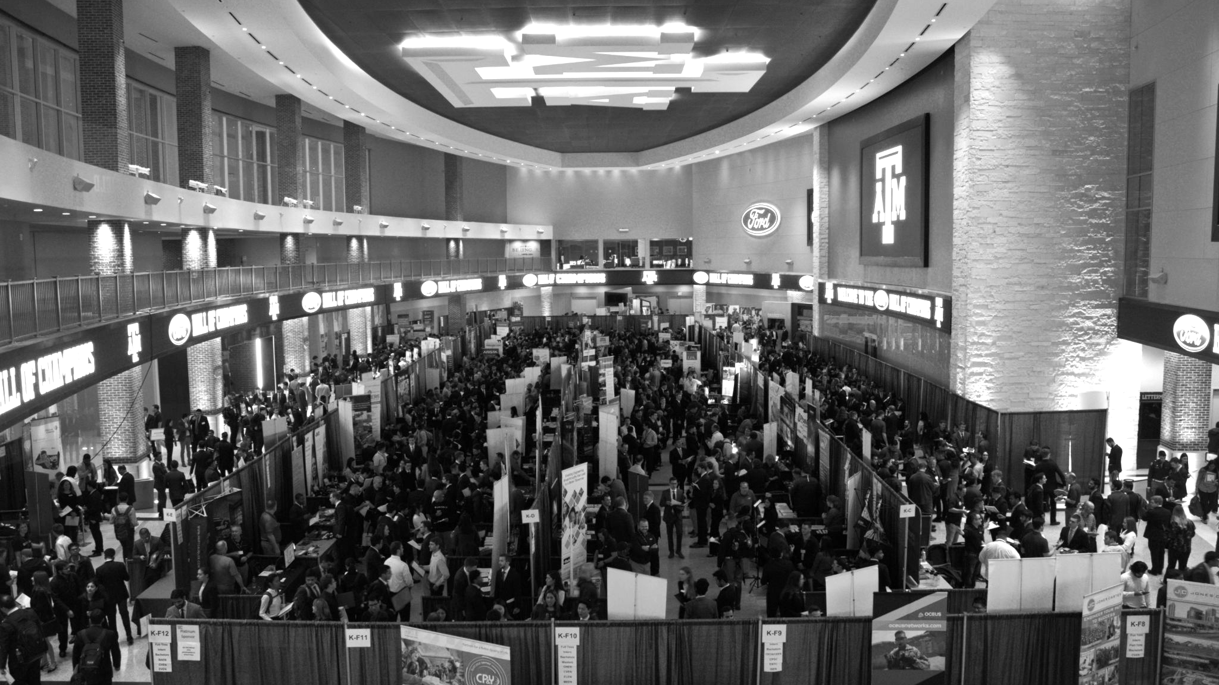

LANL Team Project Update
4/16/2025
Izzy Baumler, Dalton Boeckmann, Morgan Gullo, Jade Waldron

Slide 2
Problem Statement/Project Motivation
There is a need for a technology that has 5 DOF and can move through its full range of motion in four degrees of freedom of at least 1 Hz.

Slide 3
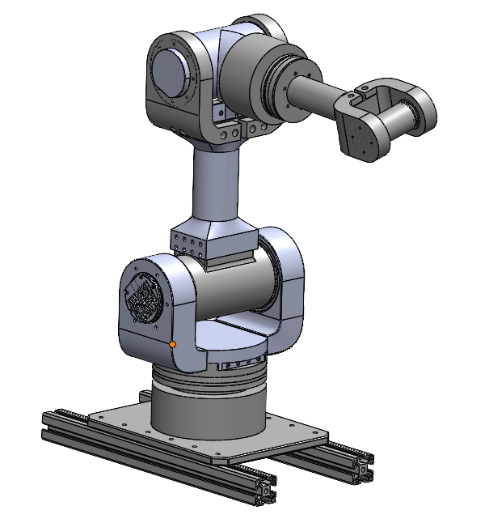
Weekly Assigned Tasks
Jade - Solidworks Refinement/Prototyping/Assembly
Izzy - Motor Research and testing
Dalton - Assembly/Motor Testing
Morgan - Purchase Orders/Electrical

Slide 4
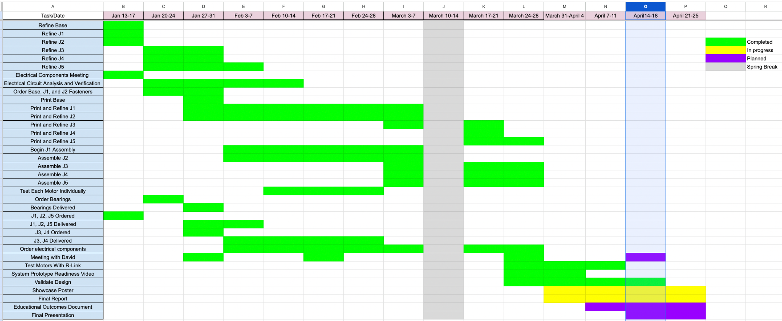
Schedule Update

Slide 5
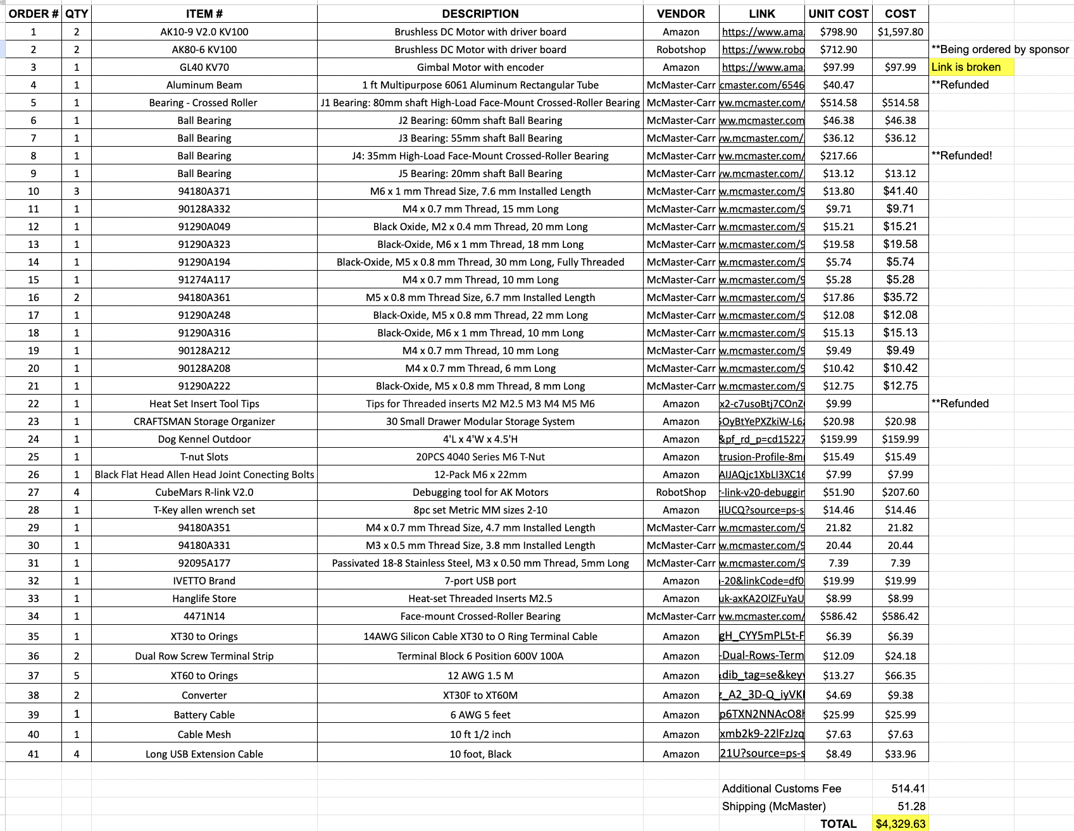
Budget Update
https://tamucs-my.sharepoint.com/:x:/g/personal/gullo_morgan_tamu_edu/EdZJe48PvNhBoXZF7swdFIcBDJovbUwwsg3bxnvpm2zjHw
The entire BOM is linked below matching the requested format by our sponsor

Slide 6
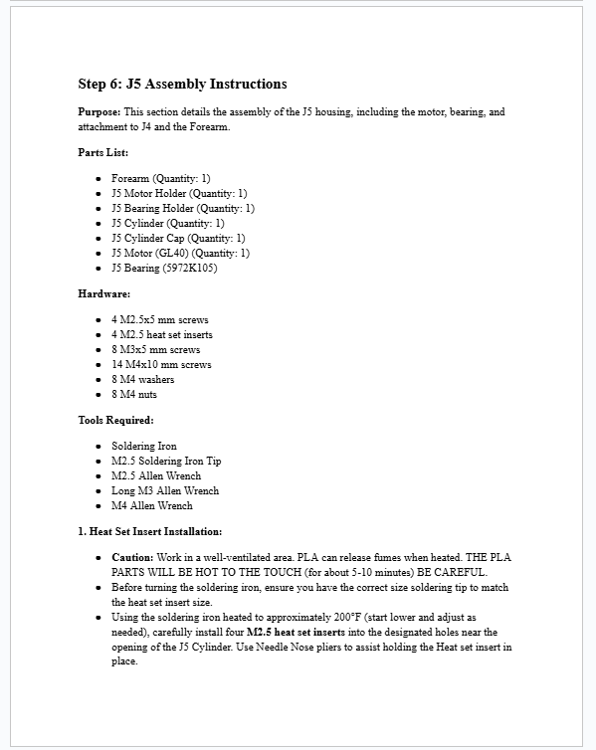
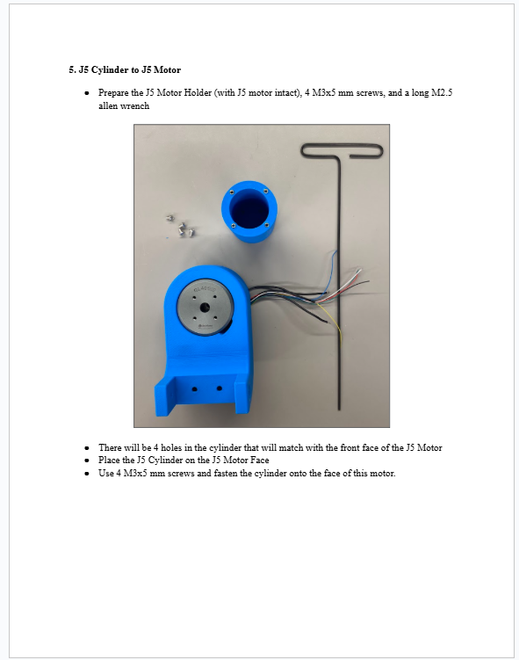
Assembly Manual
Assembly Manual 99% complete
~60 pages long (lots of figures, cover pages, etc…)

Slide 7
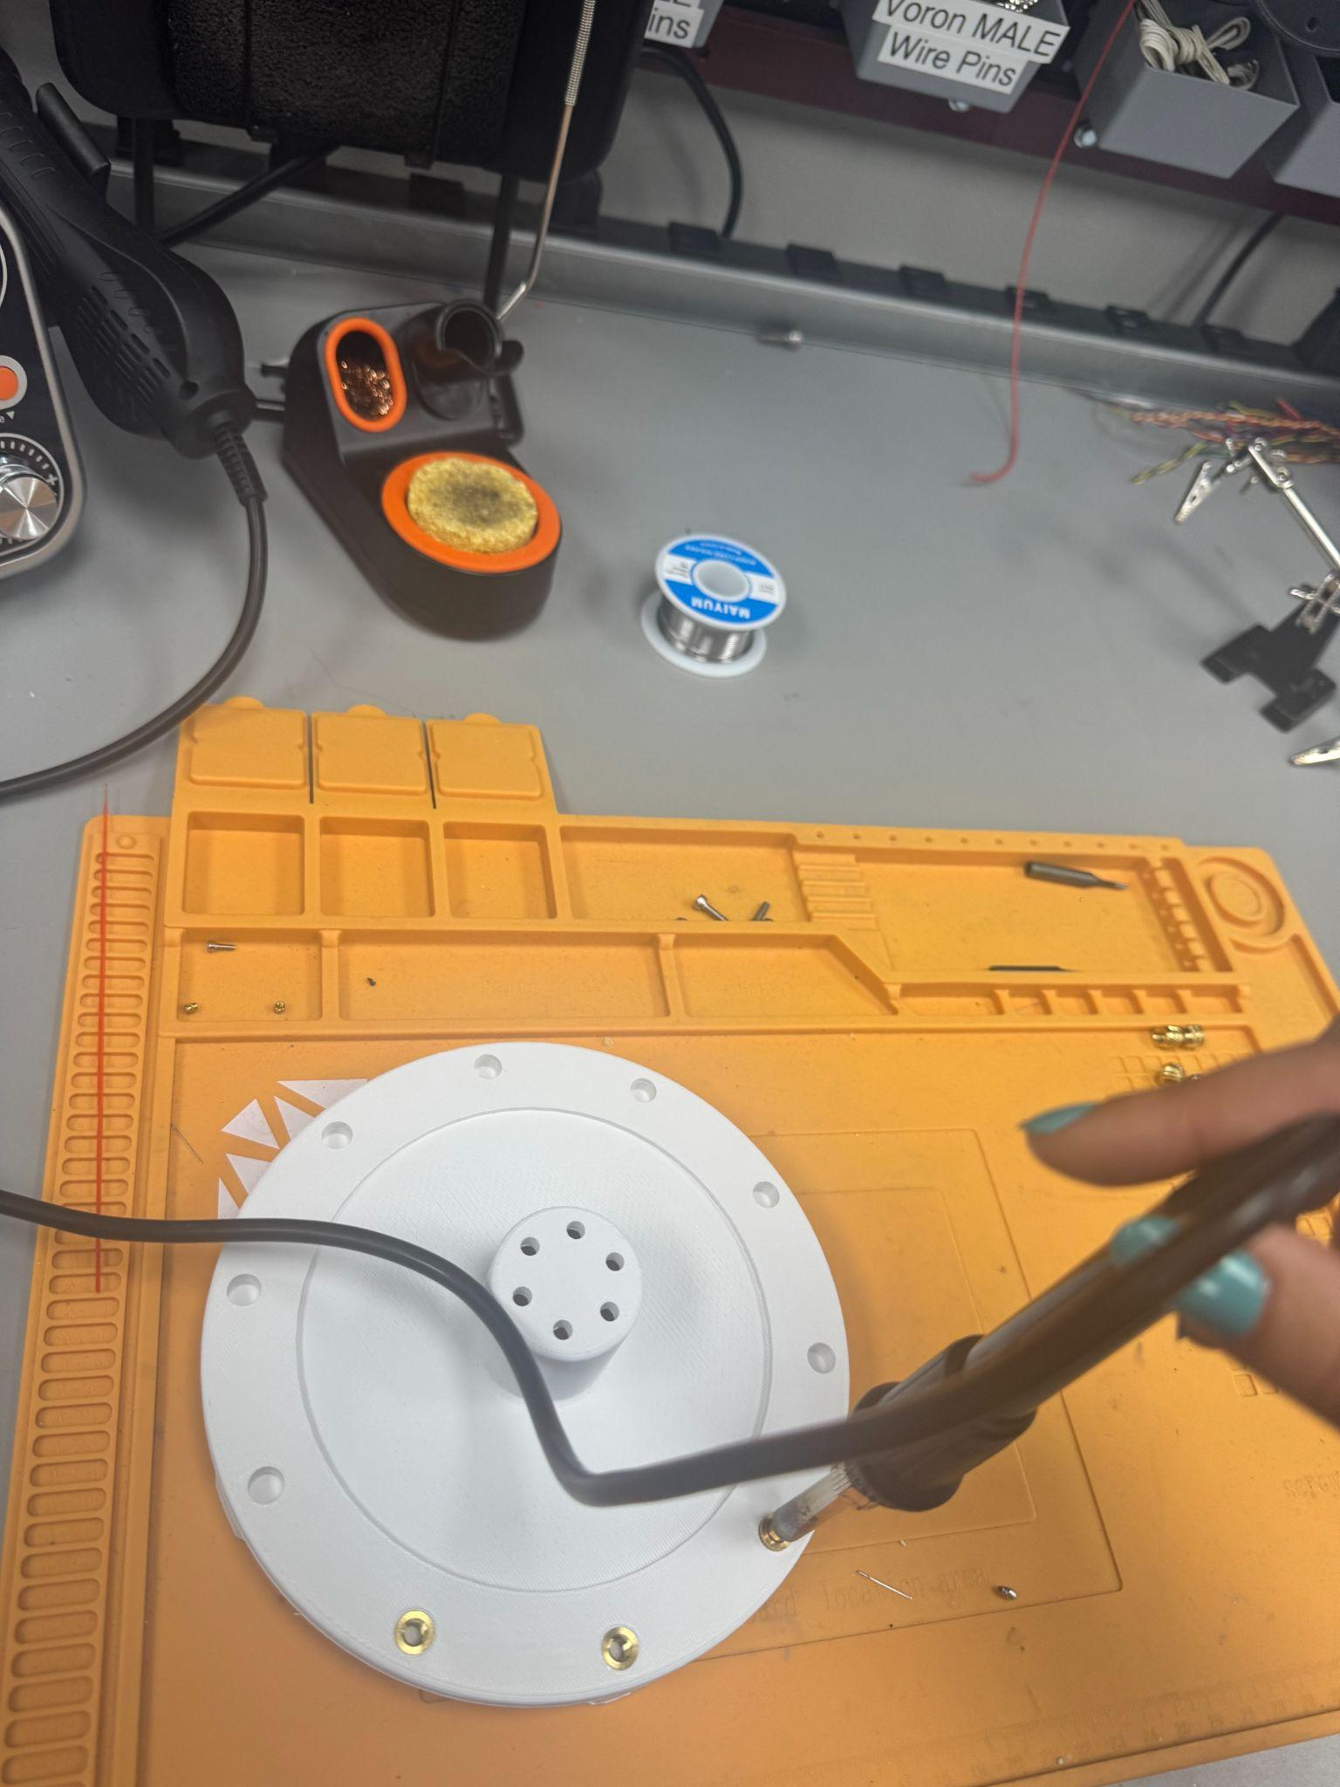
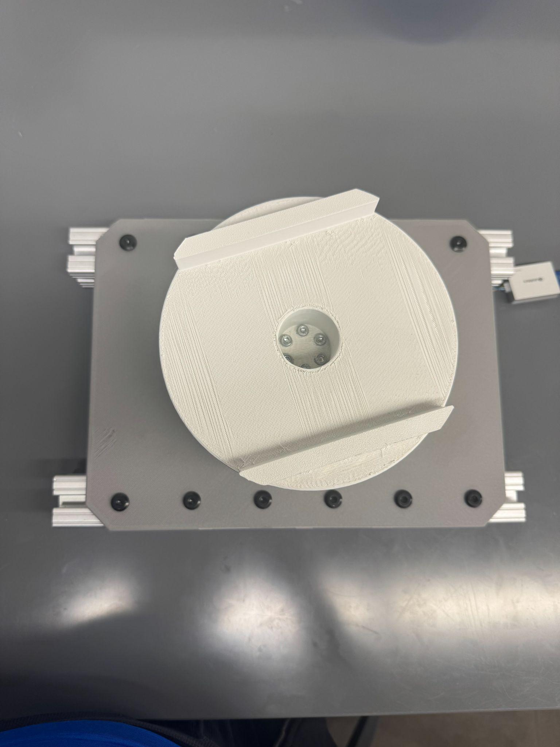
Prototyping/Assembly
New Mushroom cap was printed and assembled
Soldered 18 heat set inserts into it

Slide 8
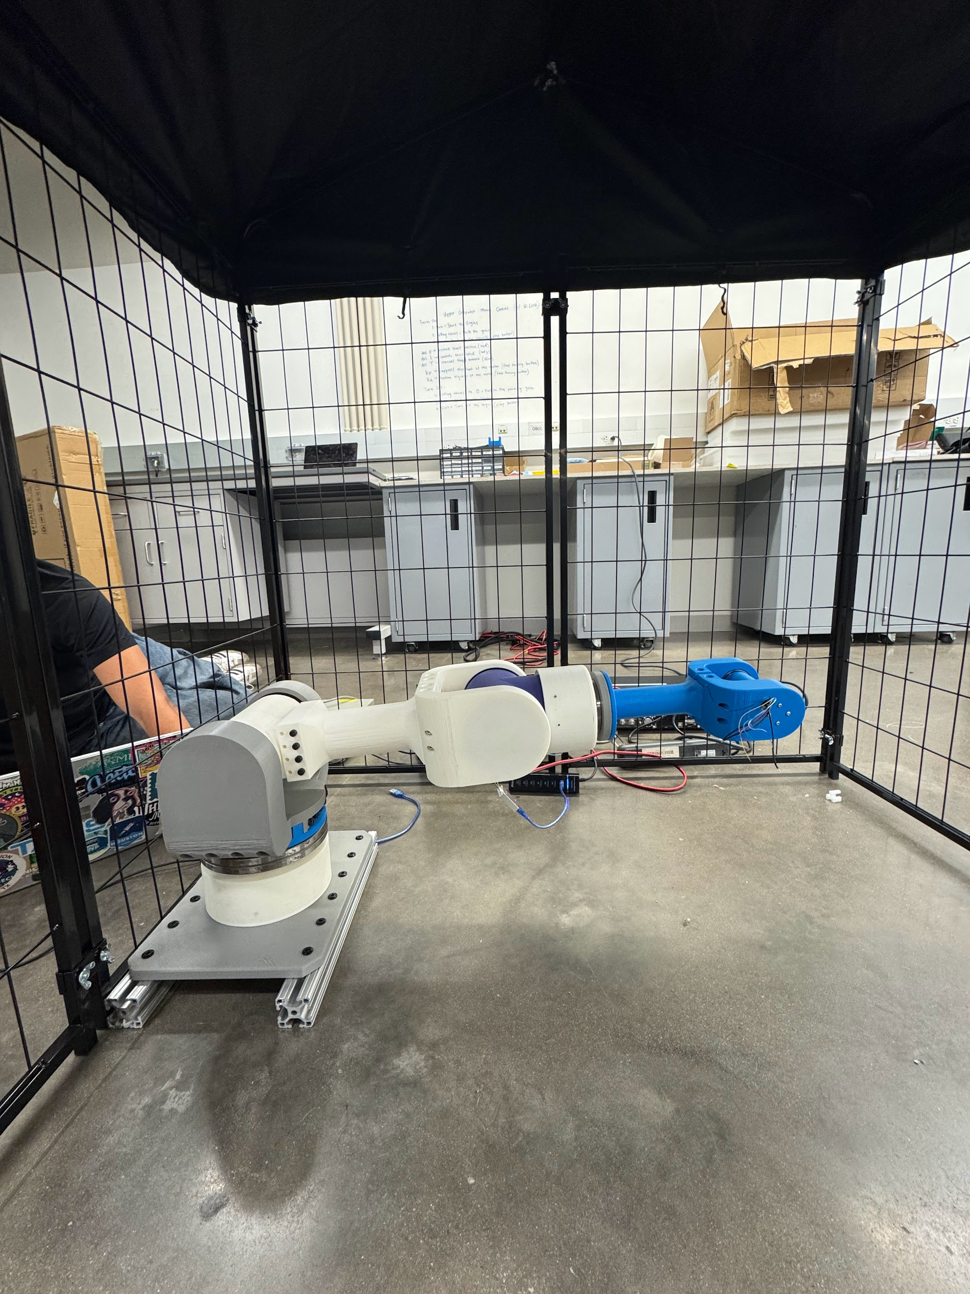
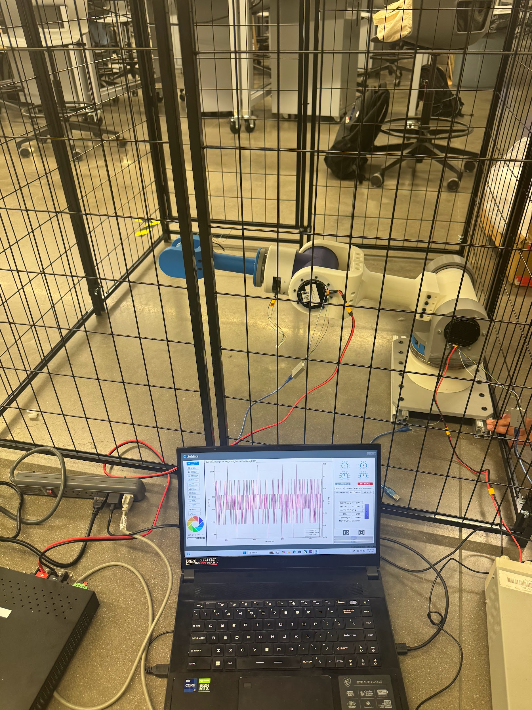
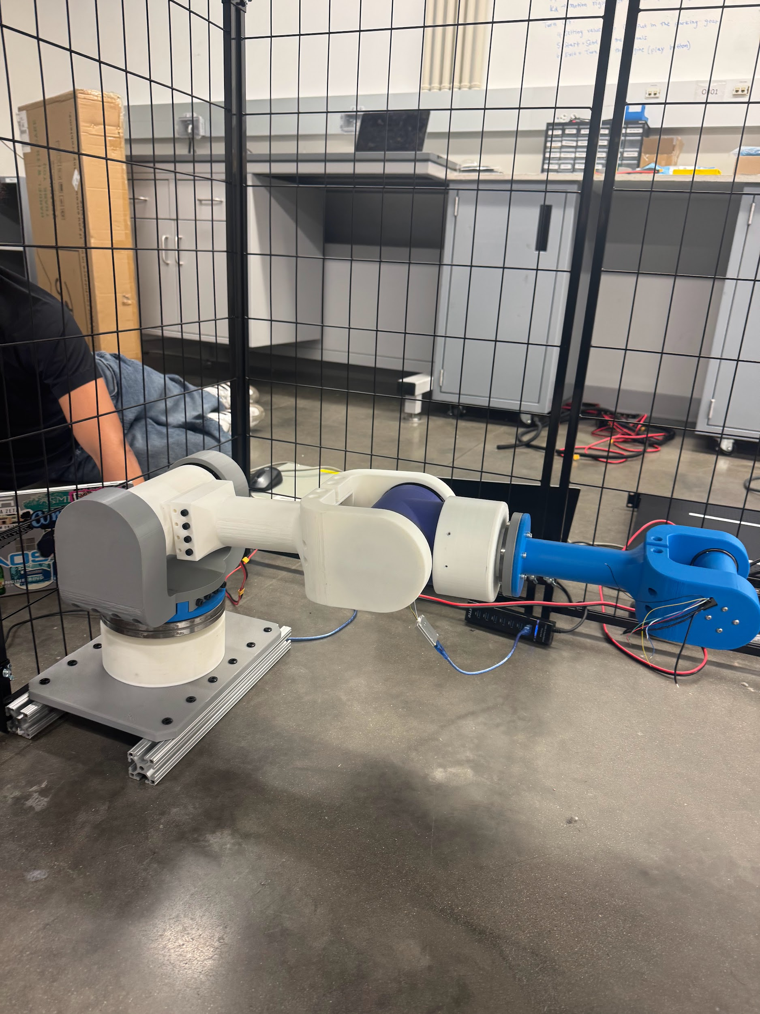
Testing
J2 Motor (with J3 off)
Torque = 12 Nm
J2 Motor (with J3 on)
Torque = 20 Nm
Amps = 0.7 A
J3 Motor
Torque = 2 Nm
Watts = 5.2 W

Slide 9
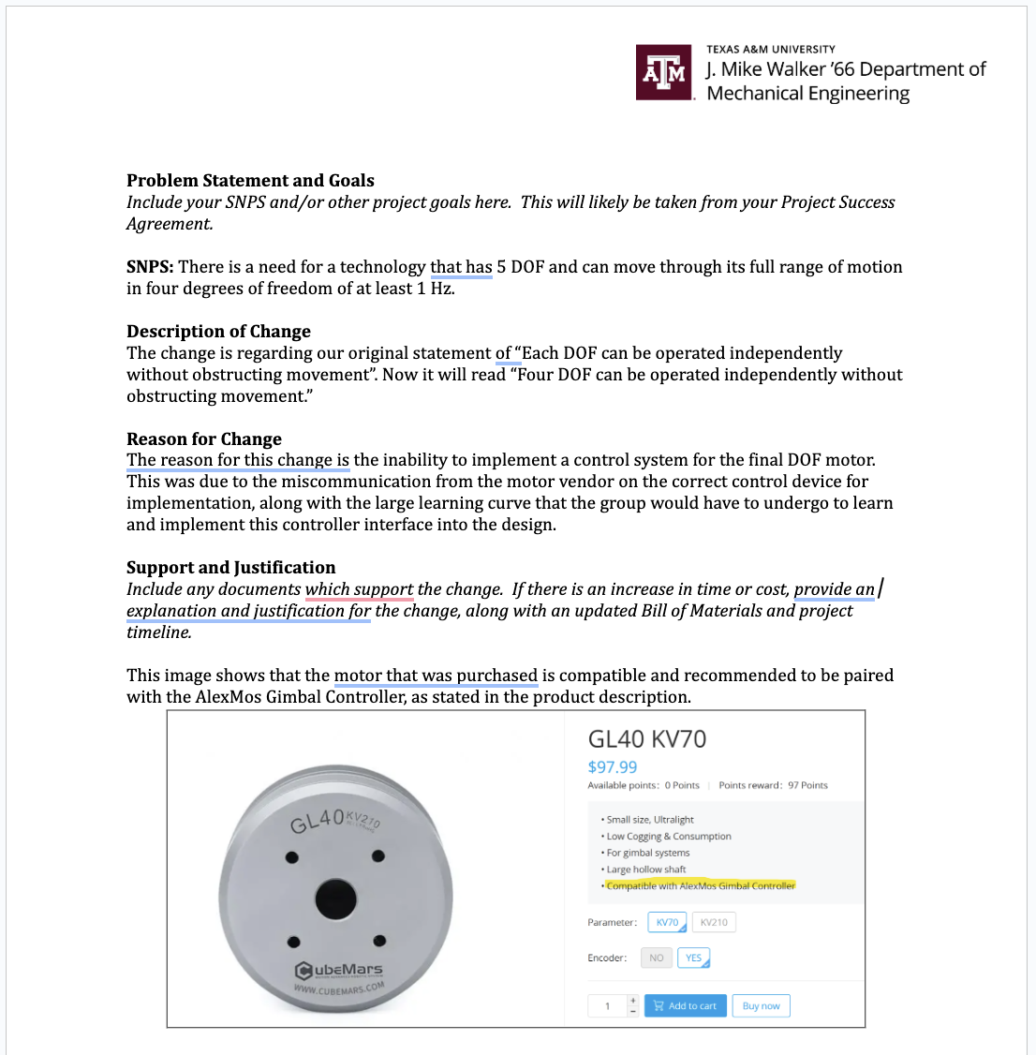
Sponsor Update
Met with Sponsor on 04/15 and expressed concerns about J5 operation
Agreed to change our Project Success Agreement and Solution Neutral Problem Statement
Wrote up a Change Order Agreement for Sponsor Signature

Slide 10
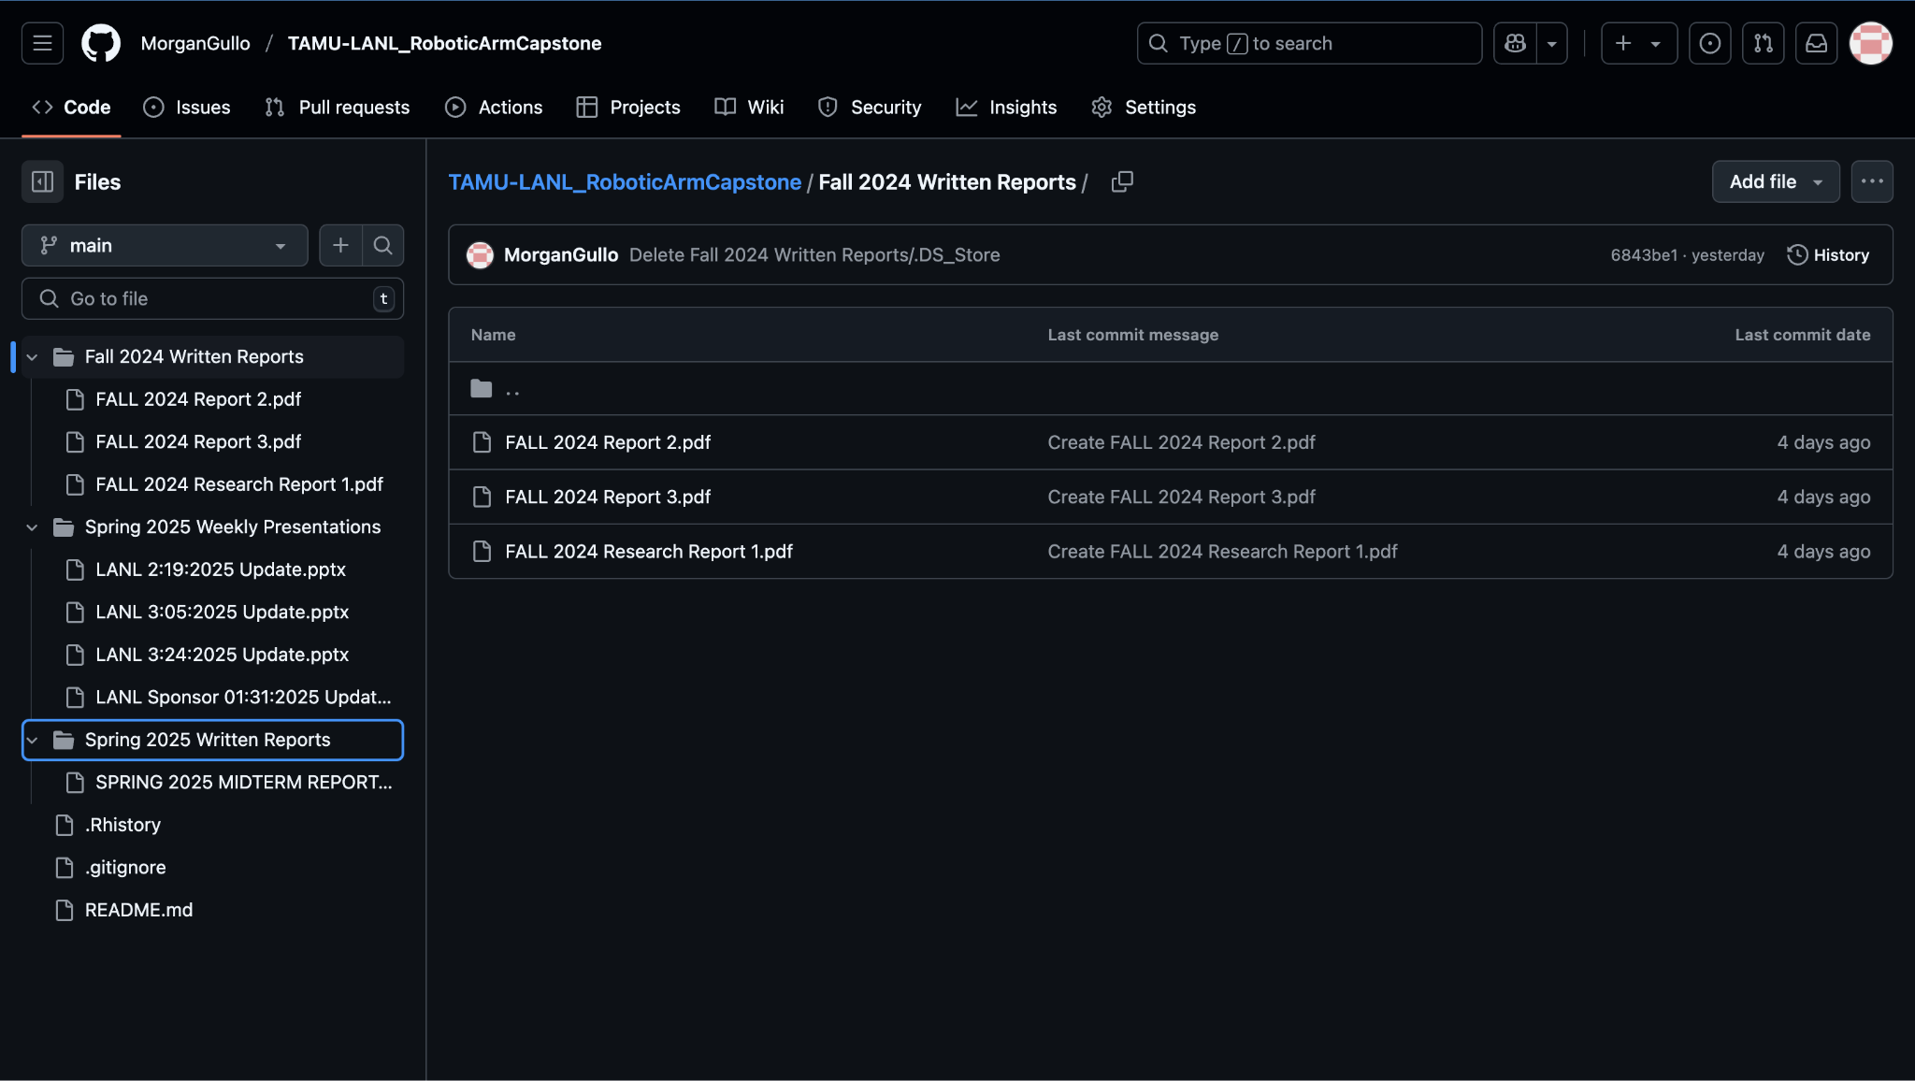
Github Update
https://github.com/MorganGullo/TAMU-LANL_RoboticArmCapstone/blob/main/README.md

Slide 11
Future Work
Film project video
Continue GitHub repository to streamline and document the assembly process
Work on Final Report, Final Presentation, and poster
Final Presentation April 24th 5:00 - 6:00 PM in Zachry Room 256

